Slide 1
Correcting Entries Training
October 2018

Slide 2
Purpose
The purpose of this training session is to review the new Correcting Entry Process and answer questions that have come up so that you can continue to request transaction, journal, and payroll corrections.

Slide 3
Agenda
What are correcting entries, journal corrections, and payroll corrections?
Why are they requested?
Who is responsible for the process?
What documentation is required?
How will I receive and respond to notifications?
How can I check the status of a request?

Slide 4
What are correcting entries, journal corrections, and payroll corrections?

Slide 5
Correcting Entries
Transactions Impacted:
Expense Reports
Requisitions
Internal Payments
P-Card Transactions
*Transaction Numbers
Transaction Updates:
Funding Source Values
Split Funding Source
Expenditure Item Date
Line Description

Slide 6
Journal & Payroll Corrections
Transactions Impacted:
Internal Payments prior to July 1, 2018
P-Card Transactions prior to April 1, 2018
Payroll Transactions
Transfers/Reallocation
Transaction Updates:
Funding Source Values
Split Funding Source
Expenditure Item Date

Slide 7
Which form should you complete?
Campus Transaction Dashboard: Payables
Always use Correcting Entry or Multiple Correcting Entry
Salary Ledger Report
Always use Payroll Correction Request
Account Analysis Report
Use the Transaction Number column to determine the appropriate form
Transfer/Reallocation
Always use the Journal Correction Request
Notes:
The link to the Correcting Entries Matrix is included to guide your decision-making regarding the appropriate form to fill out for the request. Additionally, these are the recommended reports to use for reconciliation and correction requests.

Slide 8
Why are Corrections requested?

Slide 9
Why was the process updated?
Reduce manual intervention by leveraging system functionality
Improve reporting
Enable correction of transaction before posting to the general ledger
Tether correcting entries to the original transaction

Slide 10
Why would I do a correction?
Change or split funding source for any transaction
Update transaction descriptions
Update expenditure item dates for project related funding sources
Transfer funds between funding sources
Reallocate expenses for auxiliaries and clearing accounts

Slide 11
Who is responsible for the process?

Slide 12
Funding Source Person
Each department has a designated funding source person indicated on the Approval Workflow Matrix
This person is responsible for charges associated with that department segment
They may delegate corrections to others in the unit
A Correcting Entry Request, Journal Correction Request, or Payroll Correction Request must be submitted

Slide 13
Central Administration
Accounts Payable
Processes Correcting Entries and Multiple Entries
Coordinate with OSP for project-related funding source review and approval
Administrative Accounting
Processes Journal and Payroll Corrections
Coordinate with OSP for project-related funding source review and approval
Office of Sponsored Programs (OSP)
Review and approve project-related funding source requests

Slide 14
What documentation is required?

Slide 15
Multiple/Correcting Entries
No documentation is required for these requests.
AP will review for reasonableness and request additional information if necessary
Documentation can optionally be attached for additional context for the reviewer

Slide 16
Journal Corrections
May include screenshots of original journal, invoice copy, email approvals, etc.
Preferably an account analysis report (AAR)
AA will review for reasonableness and request additional information if necessary
Documentation can either be copied into the Support tab of the template or attached separately
The Justification tab must always be completed for project-related funding sources

Slide 17
Payroll Corrections
The Justification tab must always be completed
Attach the Salary Ledger Report as documentation
The detail from the original transaction can be copied from the Salary Ledger Report and pasted into the template to ensure the correct formatting
AA will review for reasonableness and request additional information if necessary

Slide 18
Project-Related Funding Sources
The Principle Investigator (PI) must approve all correction requests
Attach an email approval from the appropriate PI as documentation
Attach additional information that OSP may need to approve the transaction

Slide 19
How will I receive and respond to notifications?

Slide 20
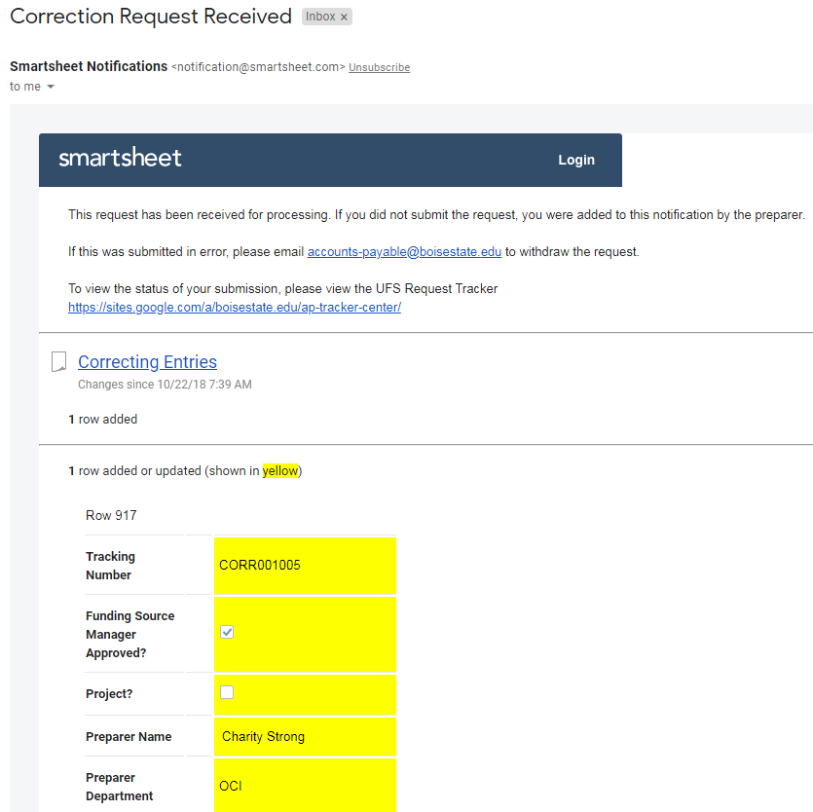
Request Submitted or Completed
Notes:
Preparers will receive notifications when a request is submitted and completed. The link in the text will direct the preparer to the tracking report to view progress on the request. Each request will also be assigned a unique tracking number.

Slide 21
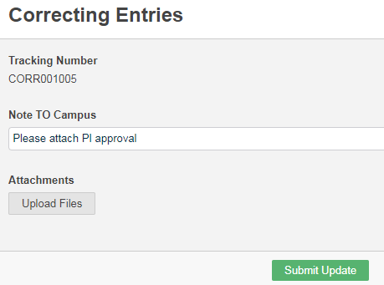
Request Requires Additional Information
Notes:
Central administration may require additional information from the preprarer. These requests will be delivered via email. The preparer will click on Open Update Form from the email, fill in the appropriate information and/or attach documentation, and click Submit Update to respond to the request from the processor.

Slide 22
How can I check the status of a request?

Slide 23
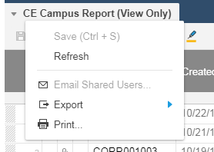
UFS Request Tracker
To find a request use
CTRL + F and the
tracking number or
Export and sort
Internal Payment Submission Tracker
Standard Requisition Request Approval Tracker

Slide 24
Resources
UFS Training Portal
Training Materials:
Tools & Resources:
University Forms & Documents
Accounts Payable Website
Administrative Accounting Website

Slide 25
Thank You!

