Slide 1
Boise State high school counselor summit

Slide 2
Pre-kickoff Thoughts
Th
In one word, how are you feeling today?
What are you most excited about for the next year either personal or professional?
What is one thing that you are hoping to learn today?

Slide 3
CHANGES TO THE 22-23 fafsa AND COMMON ERRORS

Slide 4
Common Errors Poll

Slide 5
1. Incorrect or missing FAFSA parent
2. Incorrect parent marital status
3. Answering Yes incorrectly for dependency questions (adoption, foster care, military, etc)
4. Asset questions
5. Taxable scholarship & grants, education credits, veteran’s disability, social security

Slide 6
Special conditions
Where their FAFSA income may not be reflective of their current
financial situation.
1st option: Actual 2021 Income Review. Available May 1, 2022
2nd option: Estimated Income Review. Available September 6, 2022
3rd option: Actual 2022 Income Review. Available February 1, 2023
Less common: Recommend a one-on-one appointment with a
counselor to determine alternative options.

Slide 7
Q&a

Slide 8
Financial Aid Options and opportunities
(GAP funding)

Slide 9
Gap Funding Poll

Slide 10
Federal grants yearly and lifetime limits
Federal Pell Grant: Eligibility is determine yearly based on FAFSA income. If
eligible, can receive it up to 12 semesters at fulltime enrollment. The yearly
amount is limited by each semester’s enrollment. Amounts per a semester
can range from $3,248 to $330 a semester
SEOG Federal Grant: Limited funds per an institution. We don’t have enough
funding for all eligible. They are randomly awarded to students who have a 0
EFC and Pell eligible. We stop awarding when we run out of funds. The
yearly amount is $1,000.

Slide 11
Federal Loans yearly and lifetime limits
Subsidized: Based on student’s need. Yearly maximum amount for
dependent freshmen is $3,500. Lifetime max for all students is $23,000.
Unsubsidized: Anyone is eligible. Yearly max for dependent freshmen is up
to $5,500. If a student qualified for the $3,500 in subsidized loans, then they
would only receive $2,000 in unsubsidized. Lifetime limits for all loans as a
dependent student is $31,000 ( that is subsidized + unsubsidized)

Slide 12
Ways to fill or lower the gap when federal aid isn’t enough
Parent Plus Loans
Private Loans
Consortium Agreements
Private Scholarships
State of Idaho Scholarships
Boise State regular and admission scholarships

Slide 13
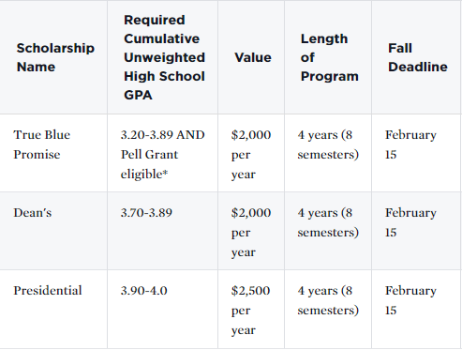
Consideration is based on admissions materials received by the scholarship deadline. A complete application includes the admissions application AND transcript(s). All criteria must be met by the deadline.
Fall 2022 Resident Deadline: February 15
Spring 2023 Resident Deadline: October 1

Slide 14
Q&a

Slide 15
BREAK
Notes:
https://www.youtube.com/watch?v=BHACKCNDMW8&t=458s&ab_channel=CatTrumpet

Slide 16
Verification
The process and how to help

Slide 17
VERIFICATION POLL

Slide 18
Verification Basics
Department of Education selects some FAFSAs
Verification is used to double check inputted information
Using the IRS Data Retrieval Tool can reduce the chances of being
selected
Forms most often asked for:
Household and Number in College
Tax information
Parent’s current marital status
We often see families who have recently gone through a divorce,
separation, or new marriage get selected

Slide 19
How we notify students
Send an email to inform them about verification
Post To Do items on their Student Center
Send monthly reminder emails if we haven’t received the documents
Documents and forms can be sent to us via:
US Mail
Fax
Email
In-person
*If the document has Social Security numbers (i.e. tax returns) it cannot be submitted via email unless redacted*

Slide 20
COVID
Verification Relief
Signed tax returns can be used instead of the
Tax Return Transcript
Signature by stylus and/or mouse allowed
TYPED SIGNATURES ARE STILL NOT ALLOWED
Some forms no longer need to be notarized

Slide 21
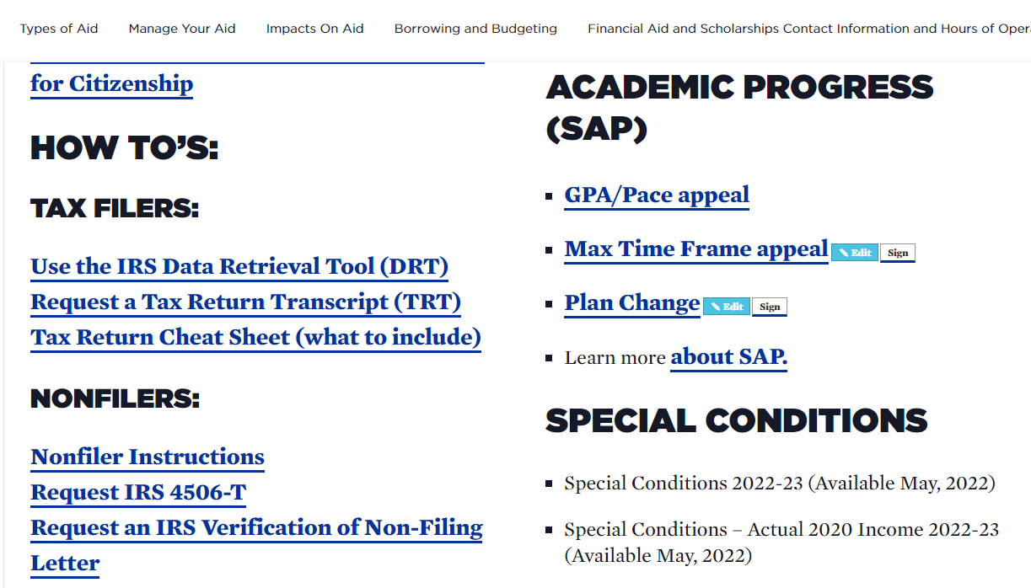
Tax Help Guides

Slide 22
Q&A

Slide 23
Break out #1
A
How Jumpstart
Credits affect future
financial aid
B
At risk and vulnerable students

Slide 24
Break out #2
A
Admissions Next
Steps
B
Supporting undocumented families and international students

Slide 25
Closing Remarks Before the Final Breakout
Have more questions? Please email us at Sunnywallace@boisestate.edu

Slide 26
Final Break out
A
Beginner
Roundtable
B
Intermediate
Roundtable

