Slide 1
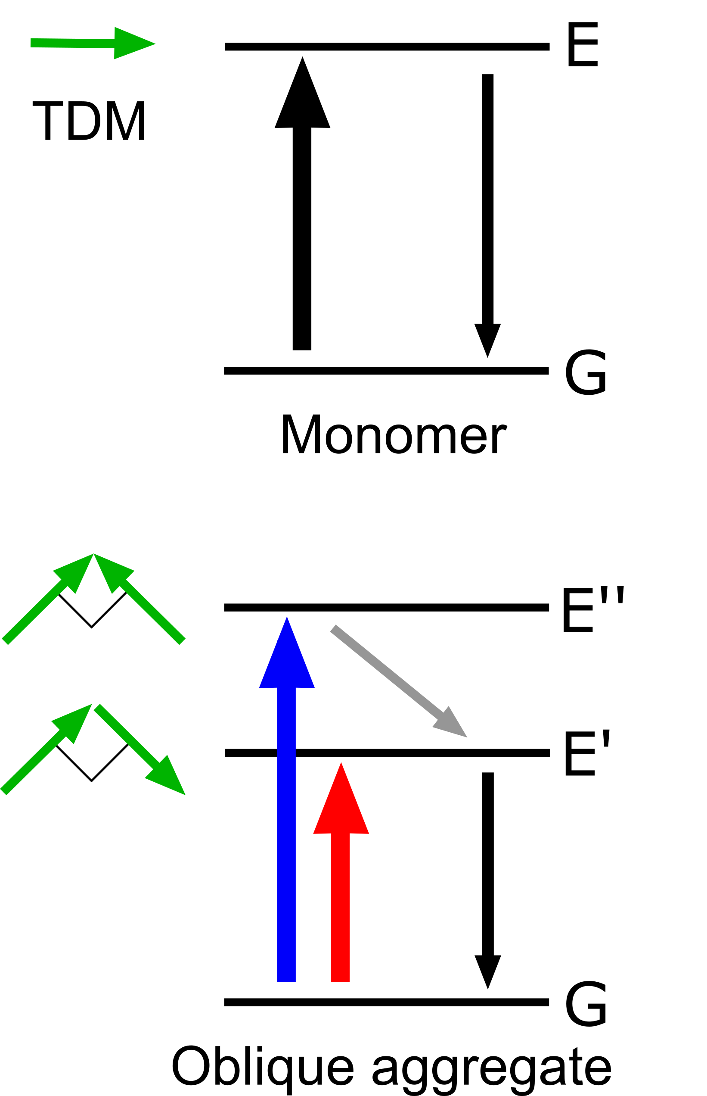
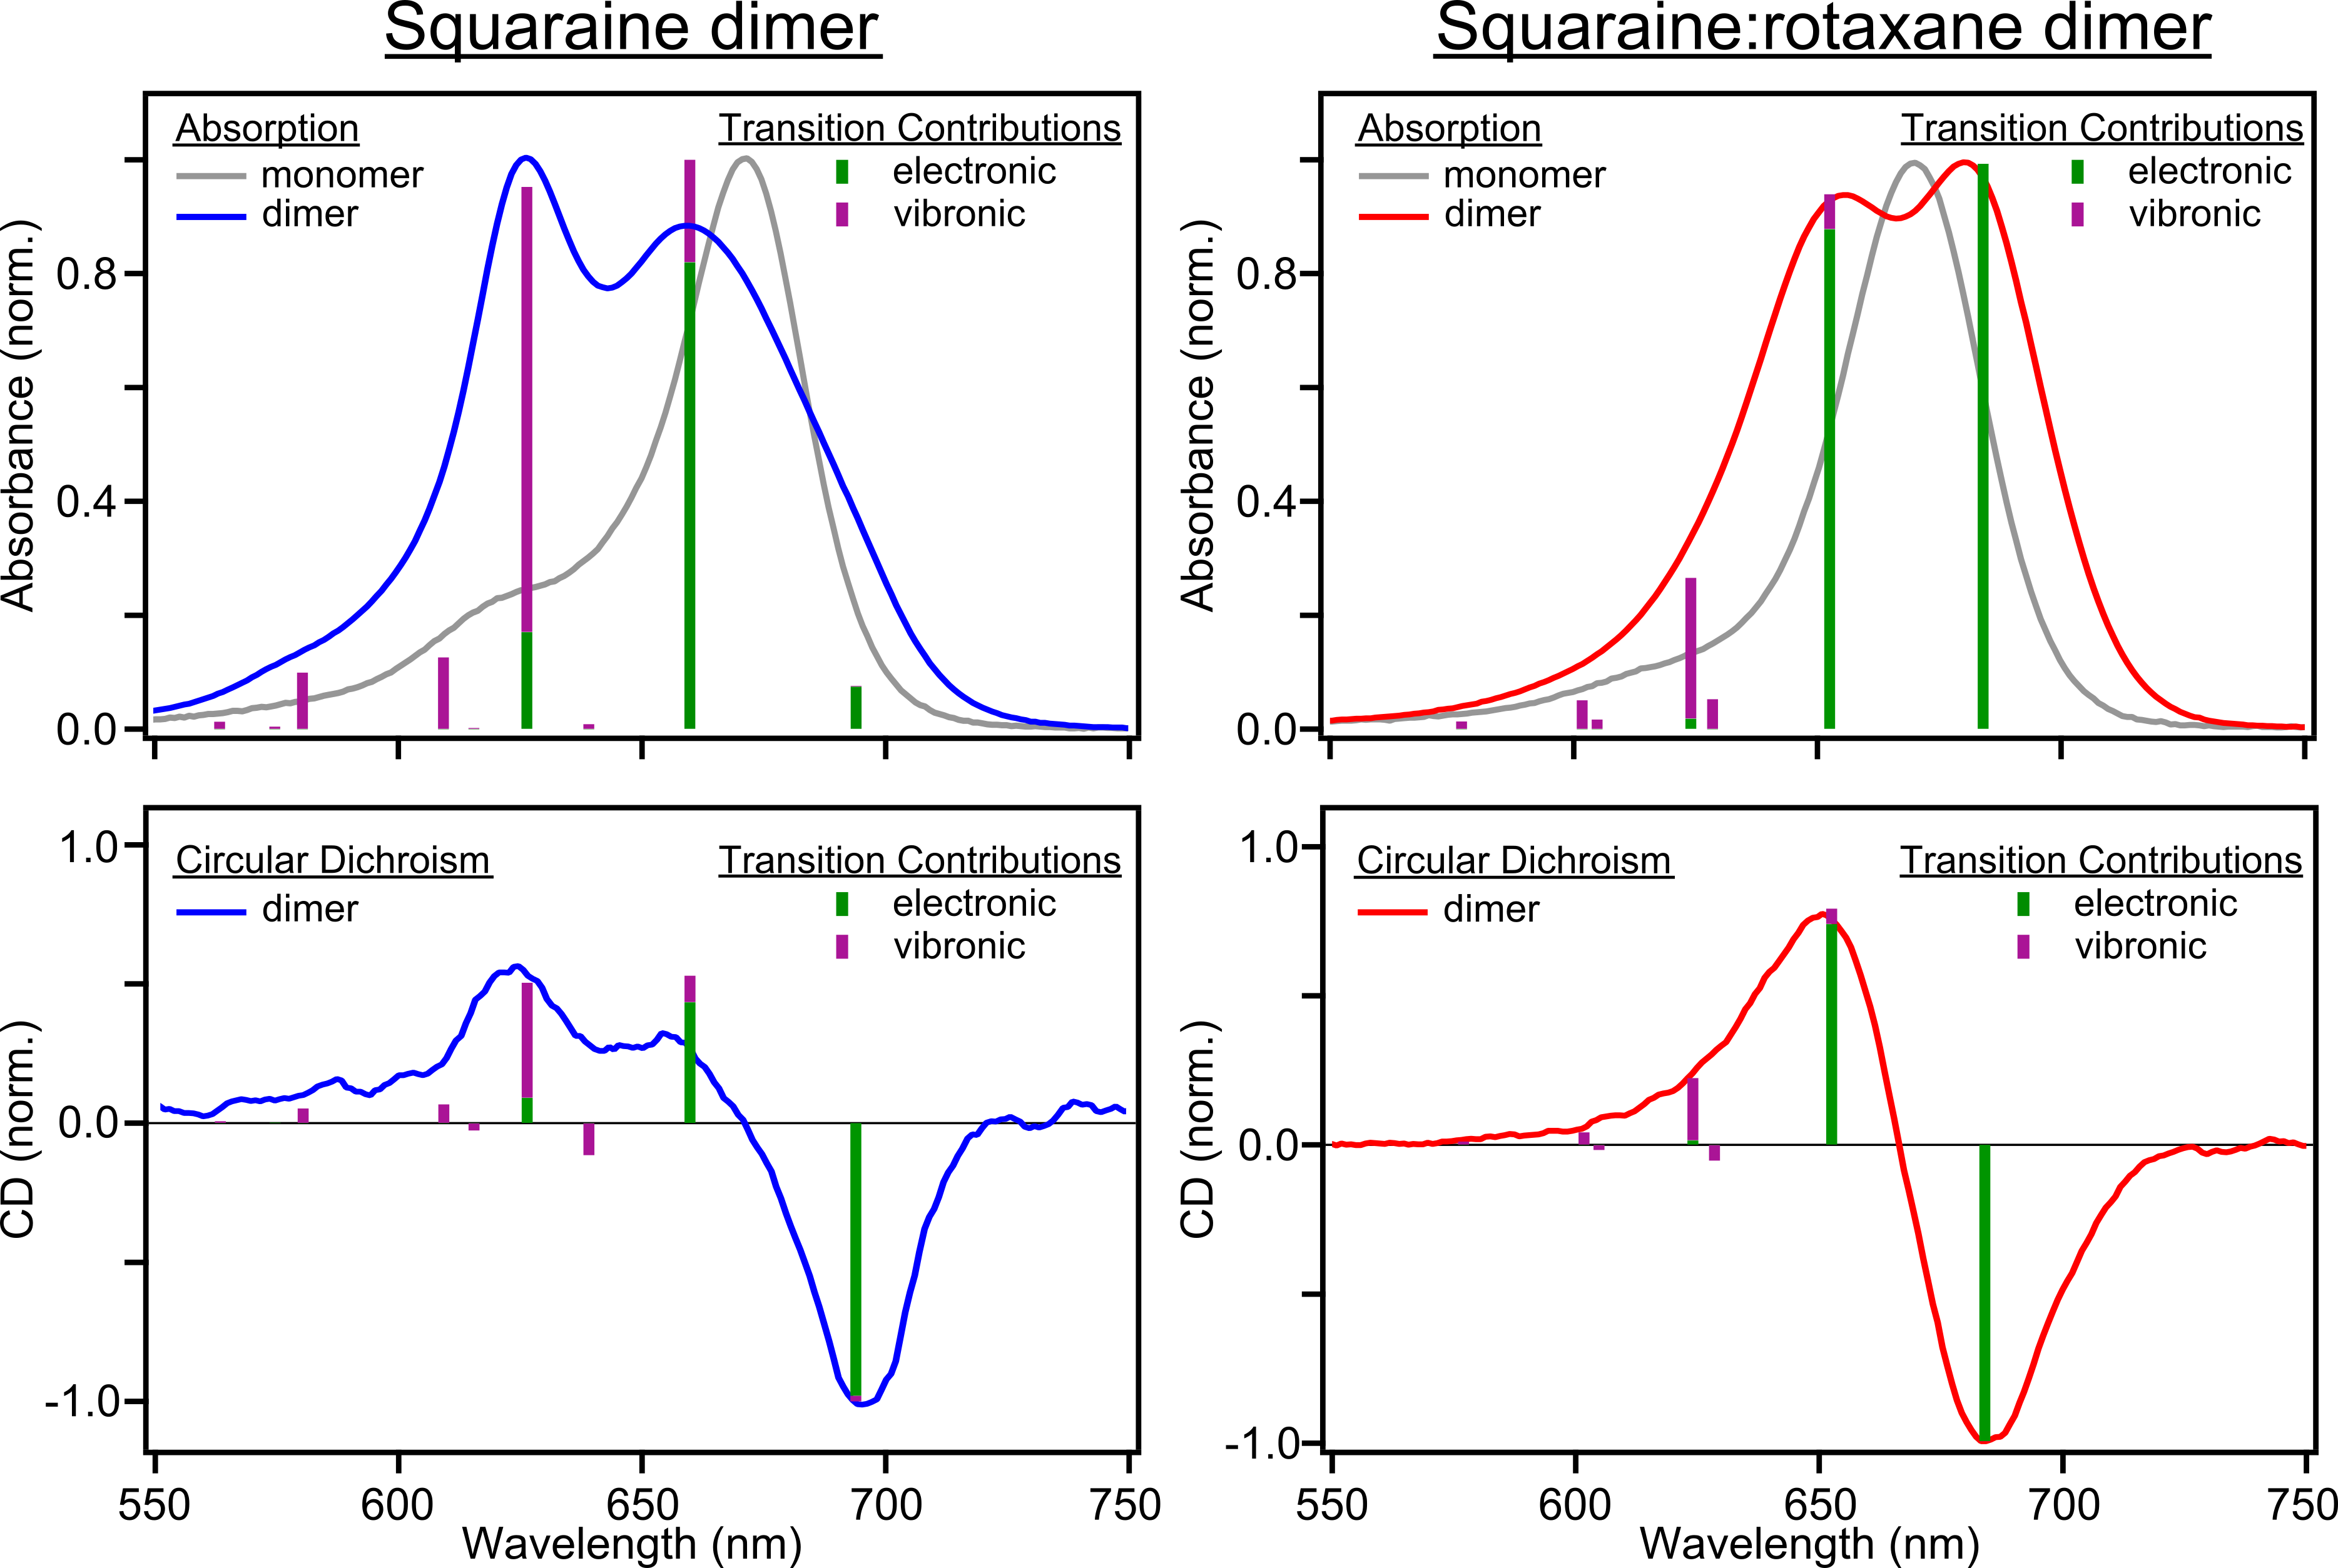
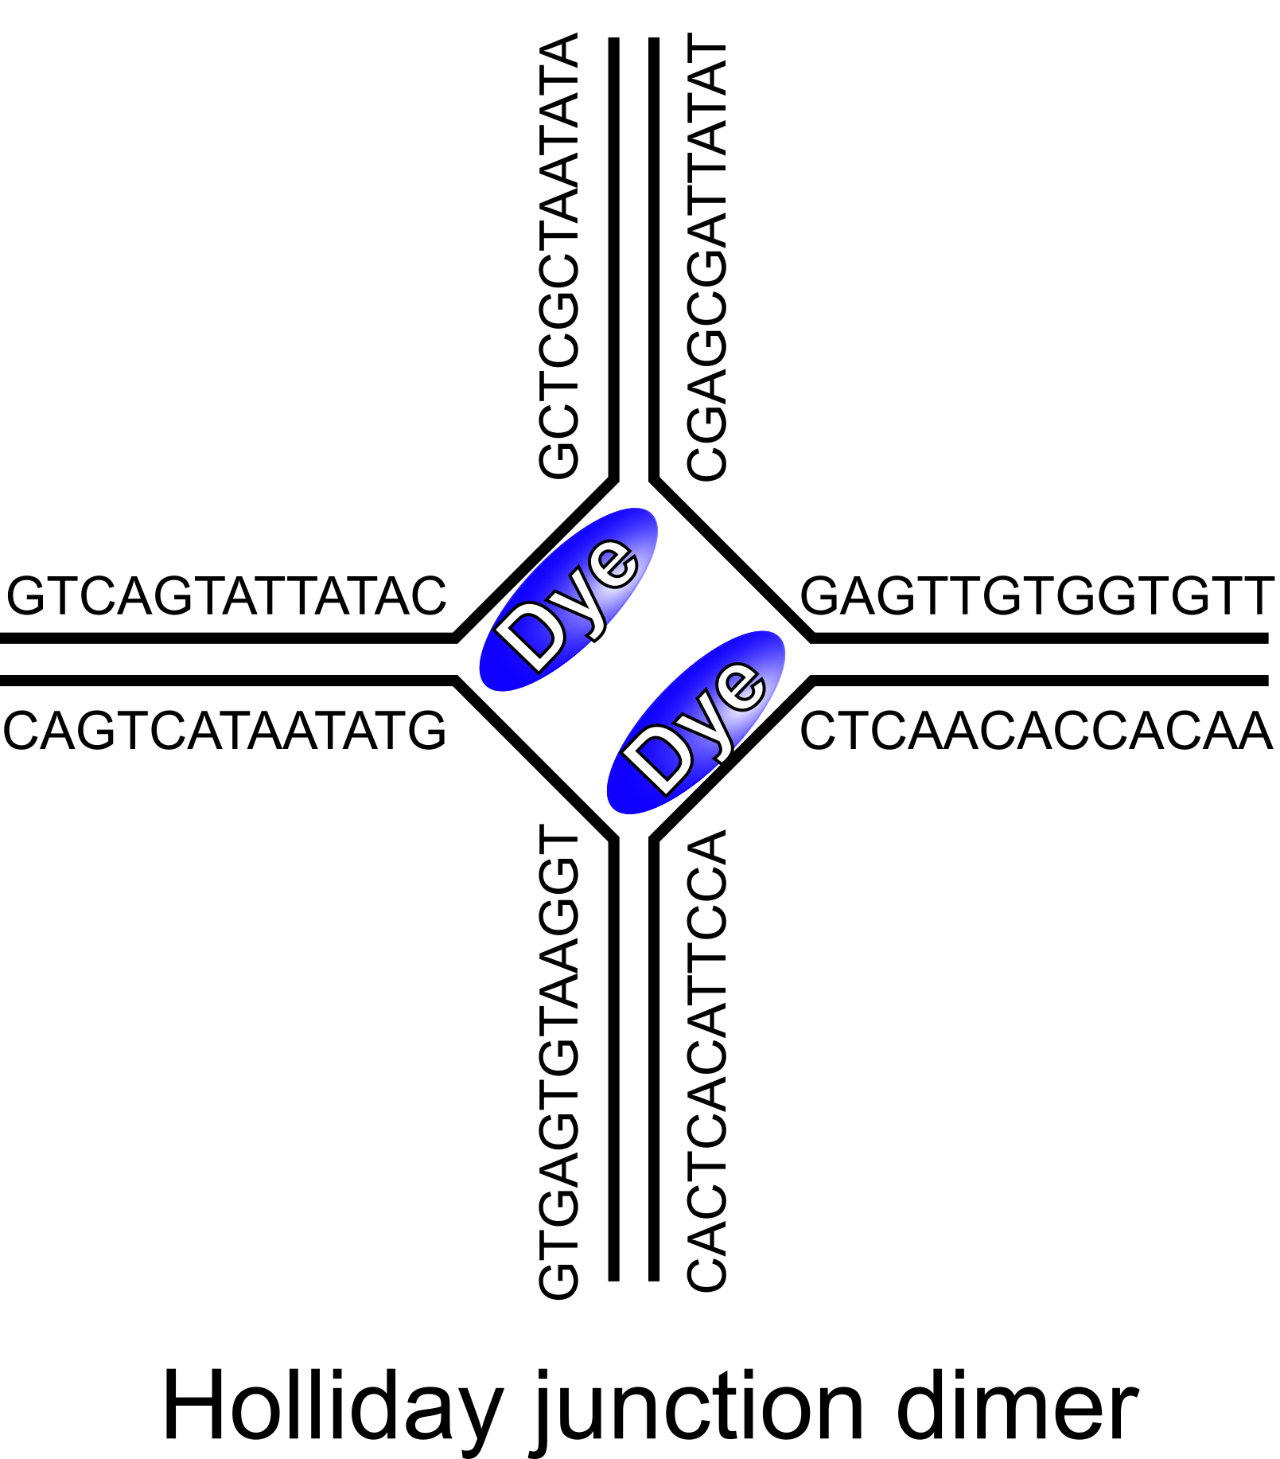
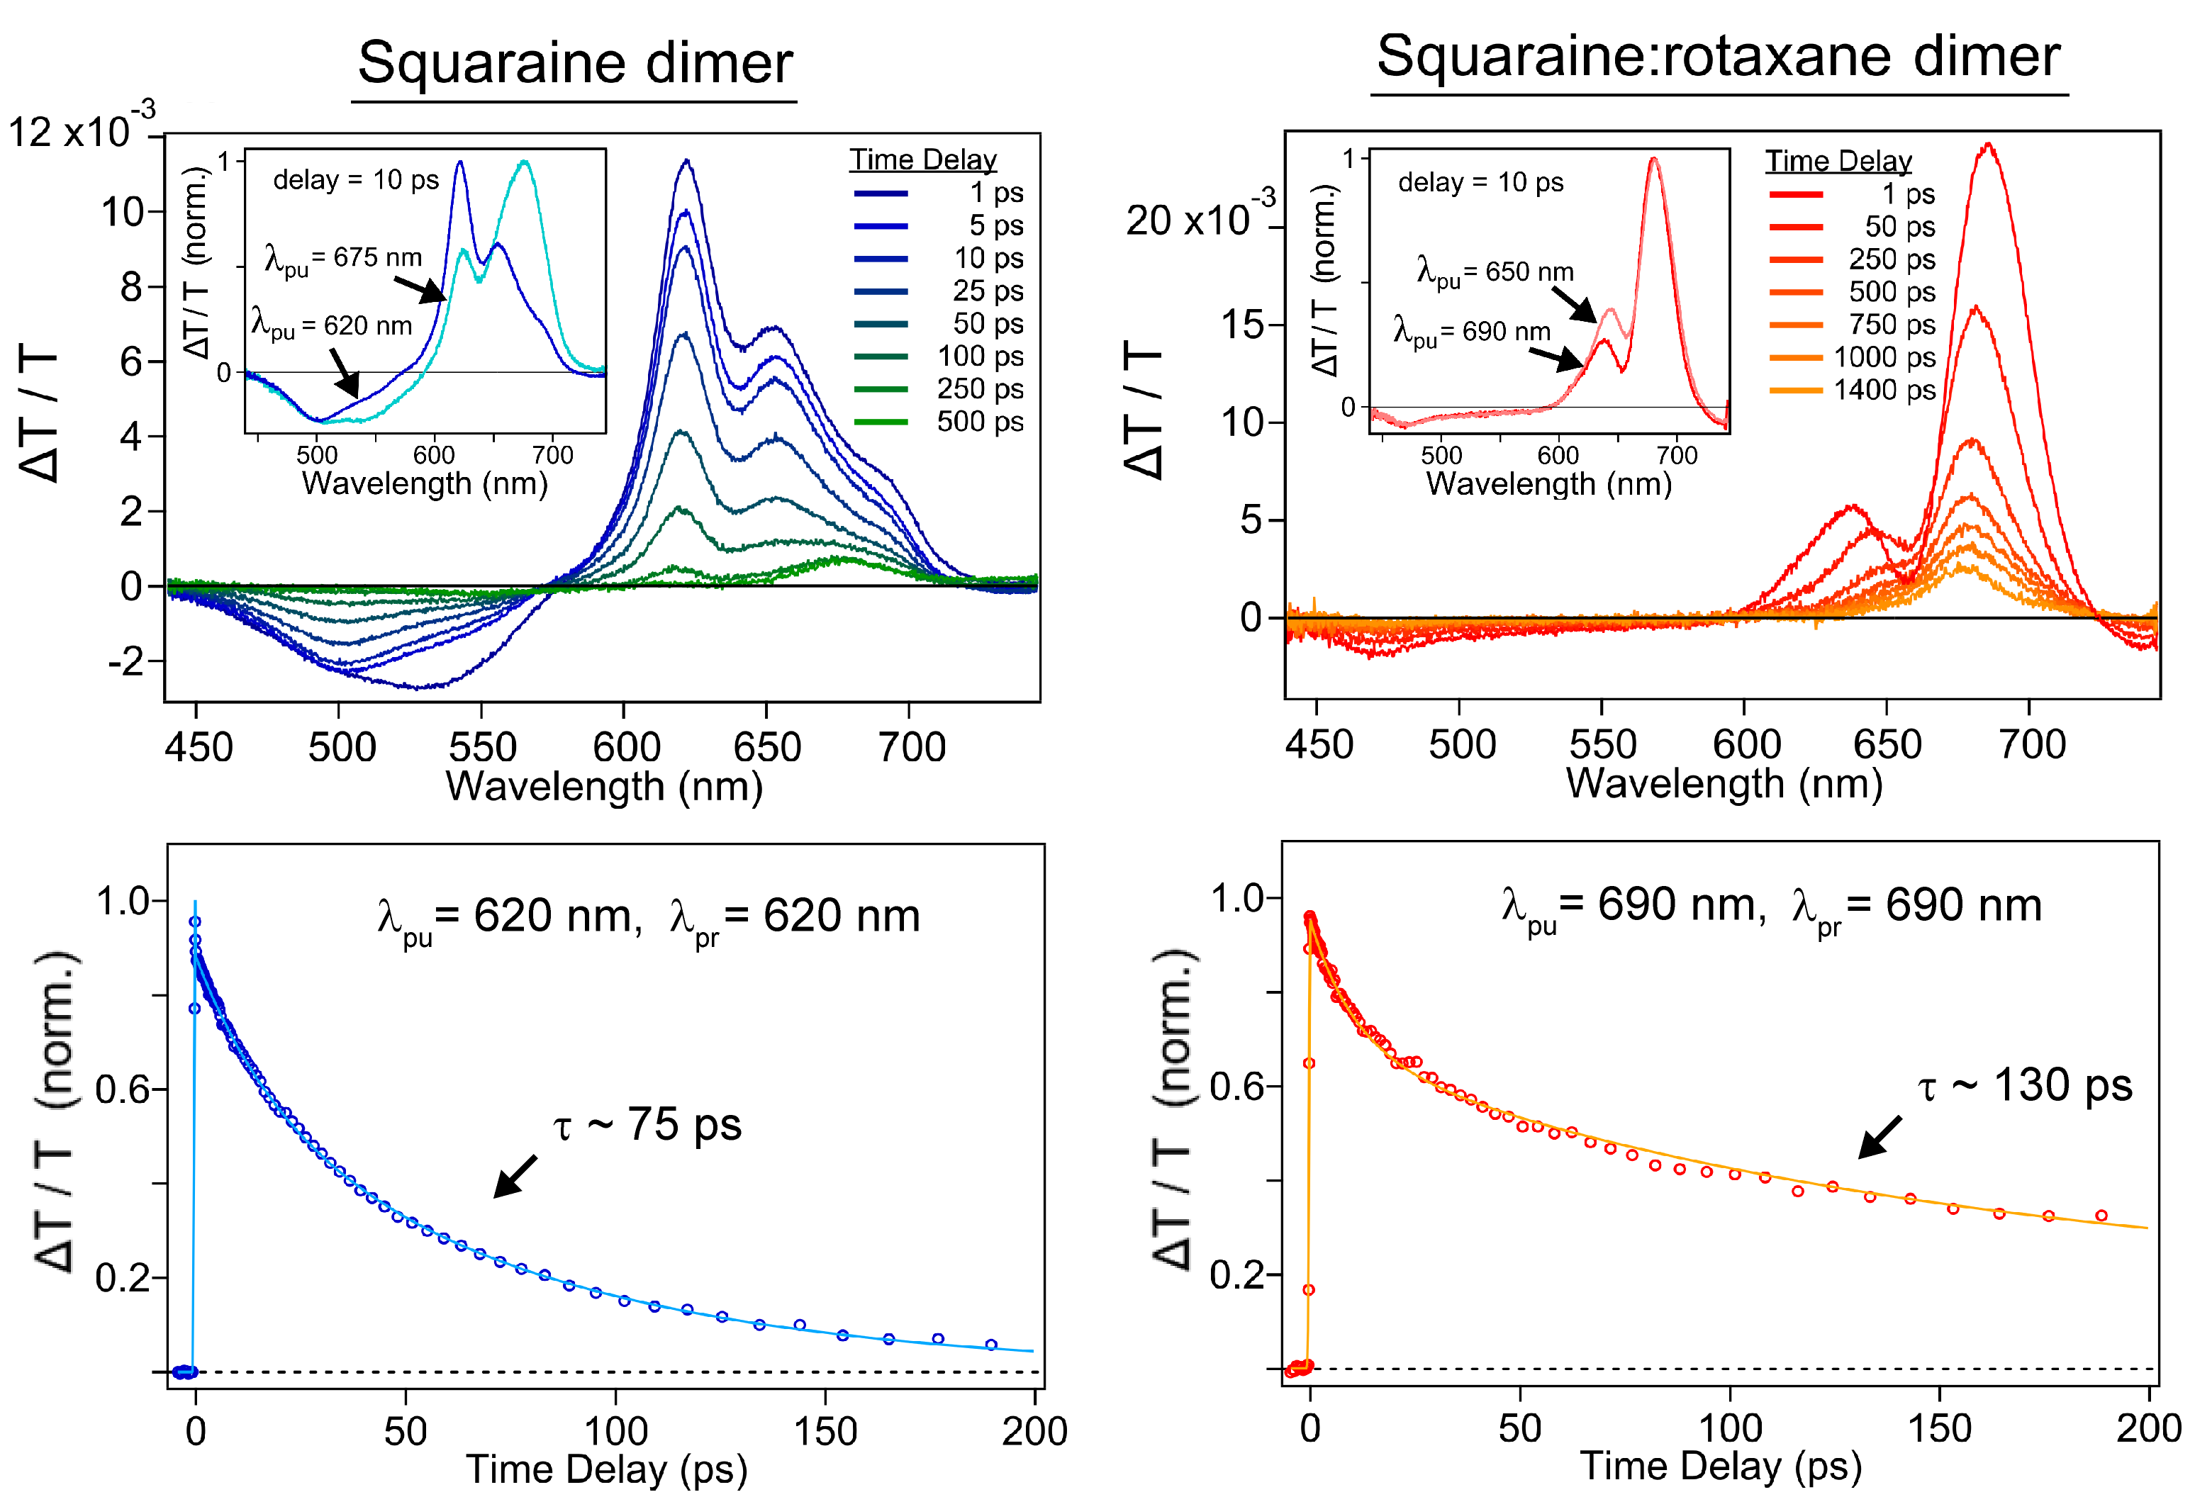
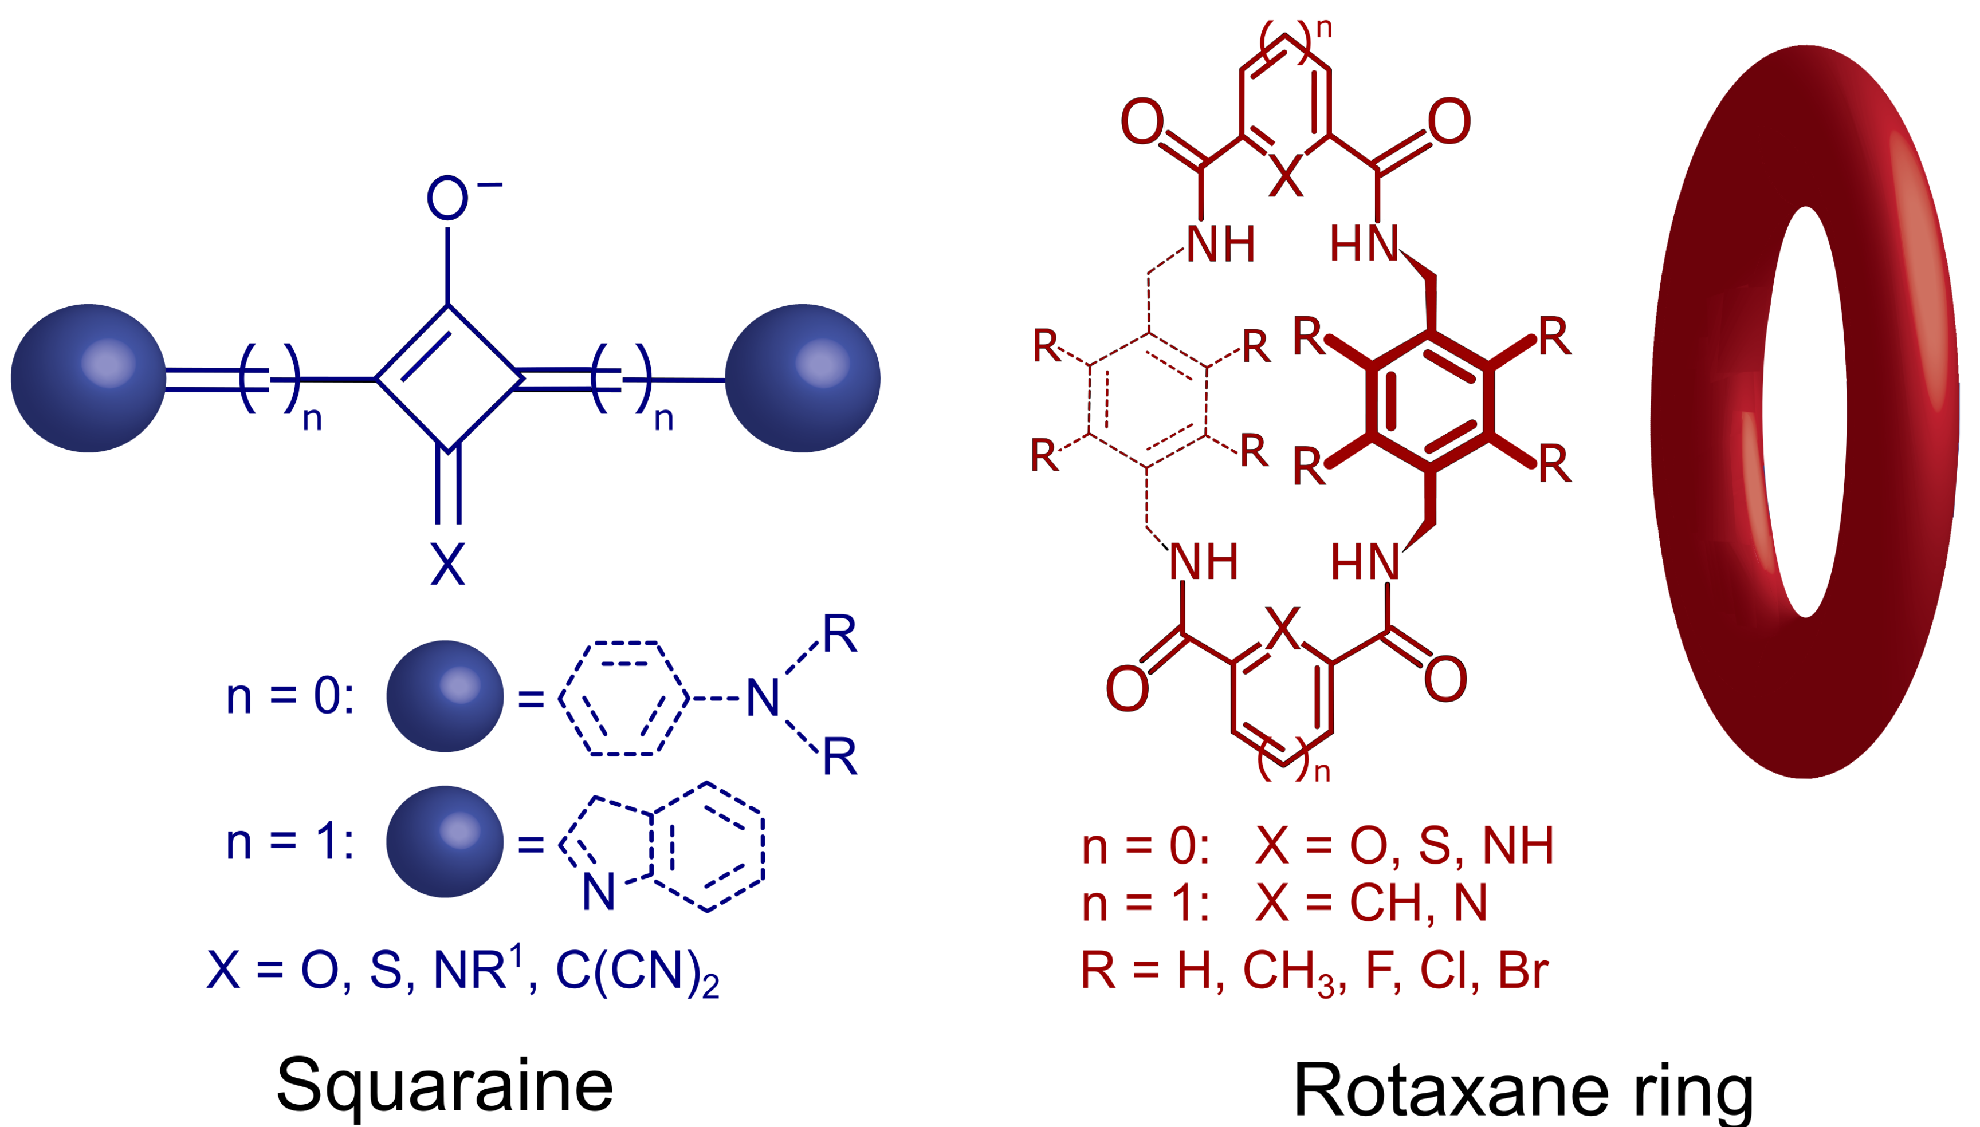
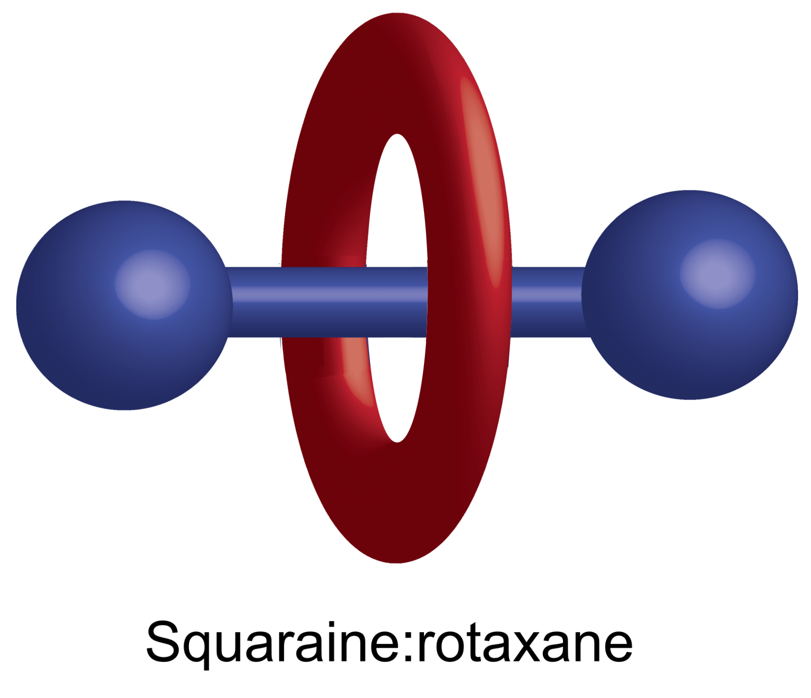
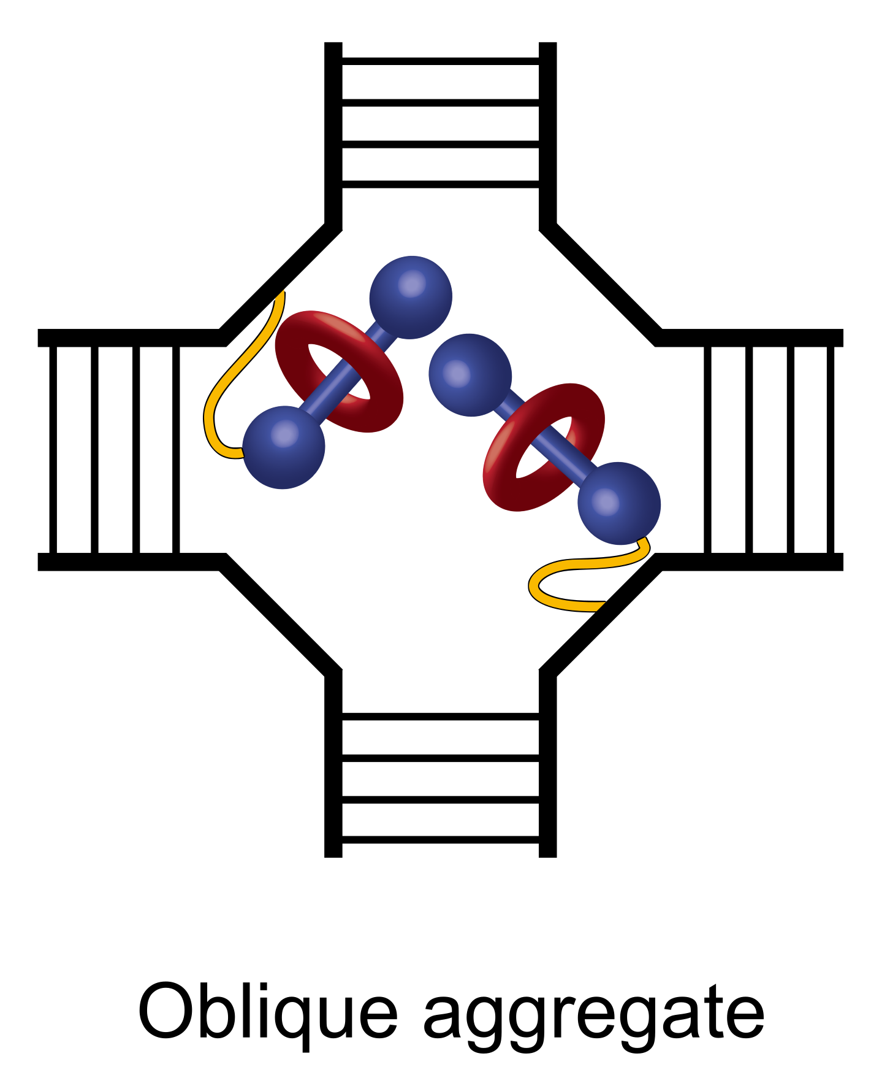
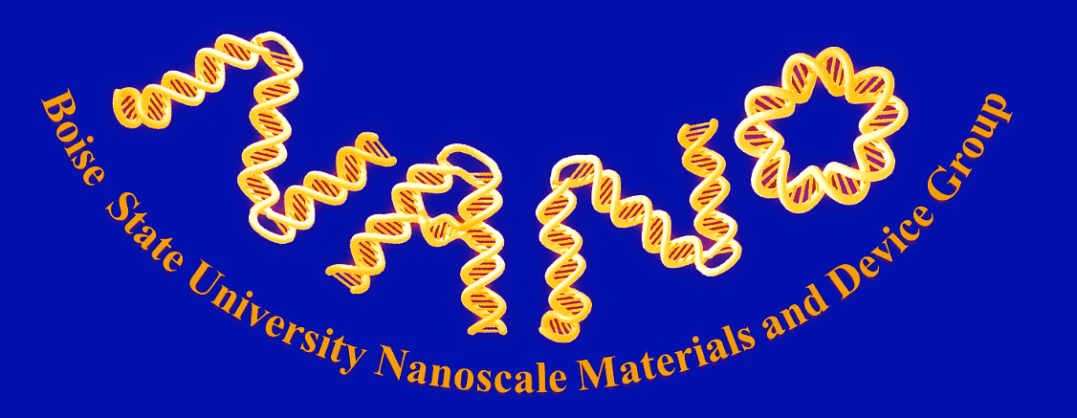
Rotaxane rings promote oblique packing and extended lifetimes
in DNA-templated molecular dye aggregates
M. S. Barclay,¹ S. K. Roy,¹ J. S. Huff,¹ O. A. Mass,¹ D. B. Turner,¹ C. K. Wilson,¹ D. L. Kellis,¹ E. A. Terpetschnig,² J. Lee,^{1,3} P. H. Davis,¹ B. Yurke,^{1,4} W. B. Knowlton,^{1,4} and R. D. Pensack¹
¹Micron School of Materials Science & Engineering, ³Department of Chemistry & Biochemistry, and ⁴Department of Electrical & Computer Engineering, Boise State University, Boise, Idaho 83725, USA
²SETA BioMedicals, Urbana, Illinois 61801, USA
Exciton Delocalization in Dye Aggregates
Excitonic delocalization occurs when two or more dyes aggregate close enough to interact, such that absorption of light forms an exciton, an excited quasi-particle of energy. Molecular excitons are relevant to numerous applications including natural and artificial light harvesting² and nanoscale computing³, but their physical properties are critically dependent on the packing orientations of the aggregated dyes. For example, when the transition dipole moments (TDMs) of two dyes are perpendicularly oriented, they form an elusive oblique aggregate with highly desirable optical properties.⁴
How can we control the molecular packing in dye aggregates to tailor the material for a specific excitonic application?
Molecular exciton model¹
Spectroscopic Evidence for Oblique Packing in SR Dimer
Dimer aggregates of commercially available SQ and SR dyes were templated using a DNA Holliday junction nanostructure and characterized via steady-state absorption and circular dichroism (CD) spectroscopy.⁴
The absorption spectrum of both dimer aggregates indicates exciton delocalization, as each dimer spectrum exhibits peaks that are spectrally shifted relative to the peak of their respective DNA-templated monomers. The SQ dimer is blueshifted relative to the monomer, indicating that the dyes are packing in a face-to-face orientation that is common to these dye aggregates.⁷ However, the SR dimer exhibits equal intensity transitions that are shifted symmetrically compared to the monomer, indicating an ideal oblique packing. The packing arrangements are further supported by the CD spectra, the largest transitions of which are consistently aligned with those observed in the absorption spectra.
Theoretical fits of the data using a Kühn–Renger–May (KRM) model⁸ confirm these packing arrangements. Further analysis indicates that the excitonic transitions in the SR dimer are mostly of electronic origin, which may be particularly beneficial for applications involving excitonic entanglement.
Schematic of a dimer dye aggregate templated in a DNA Holliday Junction⁵
Aggregation via DNA Nanostructures
One of the most promising methods of controlling the positions of dyes is covalently templating them onto strands of deoxyribonucleic acid (DNA), which provide a scaffold for assembly of dye aggregates in solution. By promoting aggregation in this manner, DNA nanostructures enable sub-nanometer control over the positioning of dye aggregates.⁶
Squaraines are a class of dyes known to exhibit excellent photostability and strong exciton delocalization when templated using a four-armed DNA Holliday junction (HJ).^{5,7} Squaraine dyes (SQ) are also advantageous because they are readily .functional
Steady-state absorption and circular dichroism spectra (CD) of the DNA-templated SQ and SR dimers. KRM modeling of the data determines the pure electronic (green bars) and vibronic (purple bars) contributions to each excitonic transition. CD spectra of the DNA HJ monomer are featureless and have been omitted.
Extended Excited-State Lifetimes in SR Dimer
Ultrafast transient absorption (TA) spectra were measured at multiple excitation wavelengths for the SQ and SR dimers aggregated using a DNA HJ. As commonly observed in aggregates of fluorescent dyes,⁶ both dimers exhibit significant excited-state quenching upon aggregation compared to the lifetimes of the DNA-templated SQ and SR monomers (τ ~ 2.9 ns), however, the lifetime of the SR dimer is roughly twice as long as that of the SQ dimer. Excitation wavelength dependent measurements show little variation in the SR dimer excited-state dynamics, indicating considerably less structural heterogeneity.
functionalized with a rotaxane ring. Squaraine:rotaxane (SR) dyes offer greater photochemical stability and were originally designed to prevent dye aggregation. However, by controlling the aggregation of SR dyes templated using the DNA HJ, the steric strain of the rotaxanes can be leveraged to obtain even finer control and promote the formation of the elusive ideal oblique aggregate.
Conclusions and Impact
By controlling the aggregation of sterically bulky SR dyes using DNA nanostructures, we observe:
Unique oblique packing arrangement with equal intensity excitonic transitions, which may be beneficial for applications involving broadband absorption and excitonic entanglement
Extended excitonic lifetimes in SR dimers, where the weaker quenching may be a result of weaker contributions from non-radiative decay mechanisms due to steric repulsion
Transient absorption (TA) of SQ and SR dimers. TA spectra at various time delays are shown for two excitation wavelengths (λ_{pu}), and kinetic traces are shown for specific probe wavelengths (λ_{pr}).
Representative structures for an SQ dye, a rotaxane ring, and an SR composite molecule. SQ dyes can be aniline-based (n=0) or indolenine-based (n=1).
References
Kasha, M. Radiat. Res. 20, 55–70 (1963).
Jang, S. J. & Mennucci, B. Rev. Mod. Phys. 90, 035003 (2018).
Cannon, B. L. et al. ACS Photonics 2, 398–404 (2015).
Barclay, M. S. et al. Commun. Chem. 4, 19 (2021).
Kallenbach, N., Ma, RI. & Seeman, N. Nature 305, 829–831 (1983).
Huff, J. S. et al. J. Phys. Chem. Lett. 10, 2386–2392 (2019).
Mass, O. A. et al. J. Phys. Chem. B 124, 9636–9647 (2020).
Kühn, O., Renger, T. & May, V. Chem. Phys. 204, 99–114 (1996).
Acknowledgments
Research at Boise State University was supported by the U.S. Department of Energy (DOE), Office of Basic Energy Sciences, Division of Materials Science and Engineering through the Established Program to Stimulate Competitive Research (EPSCoR) via award No.DE-SC0020089. Specific equipment was supported by the Department of the Navy, Office of Naval Research (ONR) under ONR award No. N00014-19-1-2615 and the Biomolecular Research Center (BRC) at Boise State.
Left: Proposed packing of SR dyes in DNA HJ
Notes:
1

