Slide 1
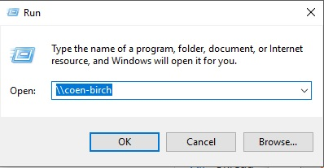
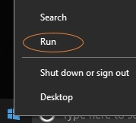
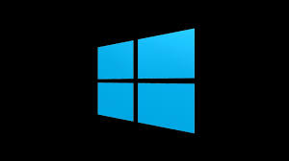
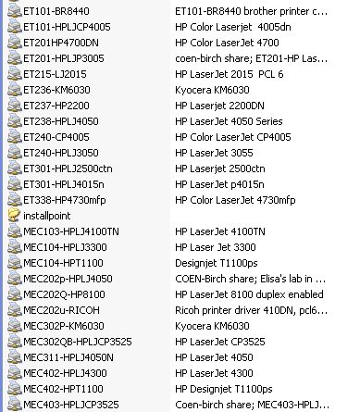
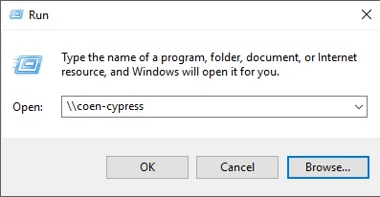
How To Access COEN Windows Domain Printers
Printer settings are user-specific; users must establish a printer connection under their own account
Right click
Windows 10 Logo
‘RUN’ field
enter \\COEN-Birch or \\COEN-Cypress for available printers
Double-click the printer object to attach to it

