Slide 1
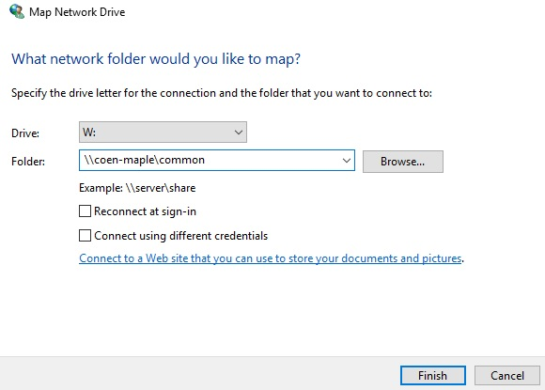
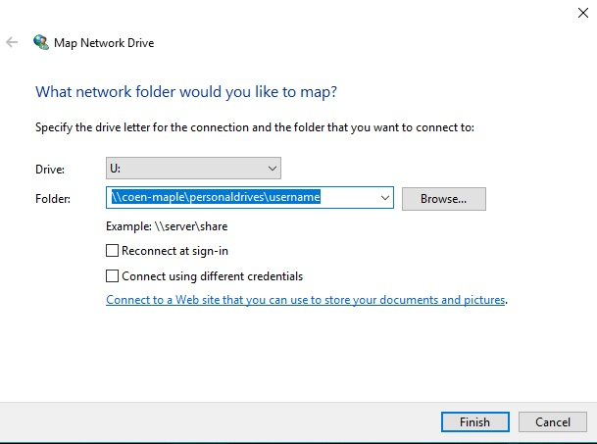
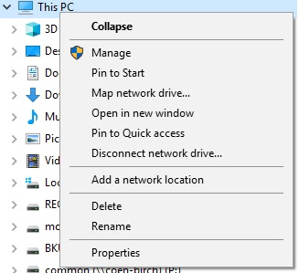
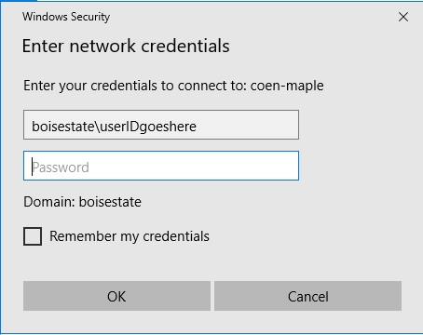
How to Map COEN U or W Drive Servers Drive Manually
Step 1:
Go to This Computer (Windows 7) or This PC (Windows 10), right click Map network drive
STEP 3: Enter Credentials
When prompted at ‘Enter network credentials’ window,
change from local PC (an ENG#) to the BoiseState or ENGR domain, and your own user ID.
The BoiseState ID and password is the same as for PeopleSoft/MyBoiseState/GoogleApps resources.
Step 2: Map Network Drive Window
Select “W” or “U” as the drive to map
W: \\coen-maple\common
U: \\coen-maple\personaldrives\username

